Slide 1
Evaluation – Setup
Different datasets:
Roman Forum ~ O(10⁵)
Berlin ~ O(10⁶)
Paris ~ O(10⁶)
London ~ O(10⁶)
World by Yahoo ~ O(10⁸)

Slide 2
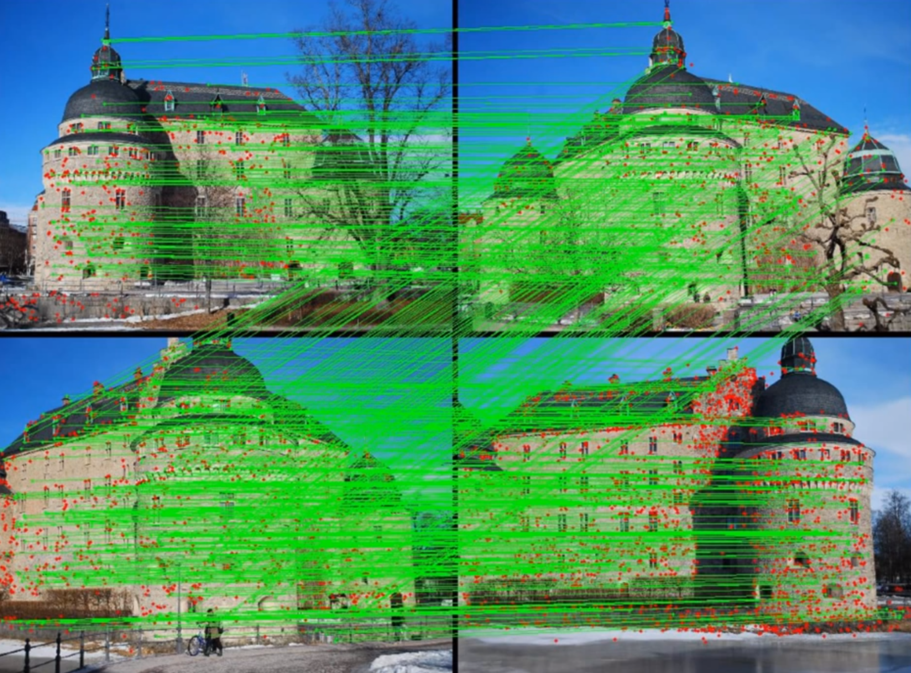
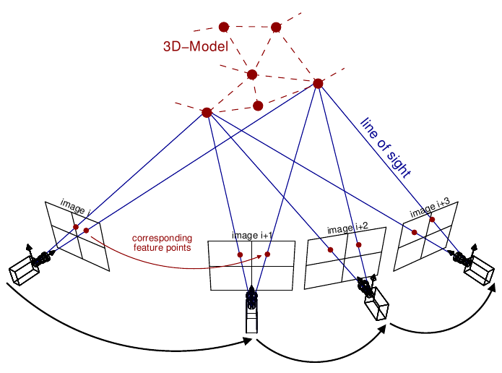
Evaluation – Setup
Different datasets:
Roman Forum ~ O(10⁵)
Berlin ~ O(10⁶)
Paris ~ O(10⁶)
London ~ O(10⁶)
World by Yahoo ~ O(10⁸)
Image match algorithm:
>= 30 inliner matches
Ignore images if > 70% of inliners are along the outer boarder (watermarks)
Positioning camera in existing 3D model requires >= 50 P3P

Slide 3
Evaluation – Benchmark → Improvements
Results & Comparison:
I/O Bottleneck: Harddrive too slow
Roman Forum (MatchMiner)
~4.7x faster (PC vs 53-node cluster)
More images (~ +11.7%)
~1.5x better connectivity
Berlin (Frahm et al.)
~2x more registered photos
~14x faster
Berlin/London/Paris:
Registration rate of ~25%
Computation rates scale linearly
State-of-the-art model completeness
Improvements:
7 high-performance HDDs
Render down to 640x480 pixels
Use >5x memory
More powerful GPUs

Slide 4
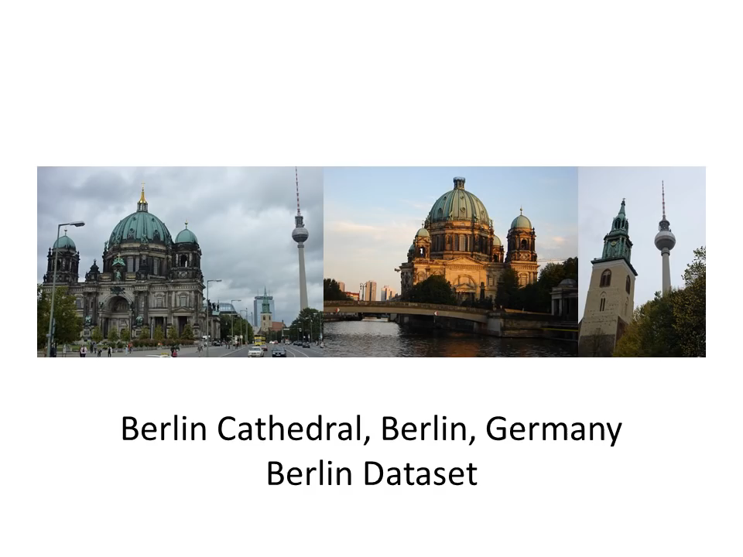
Evaluation – World Results

Slide 5
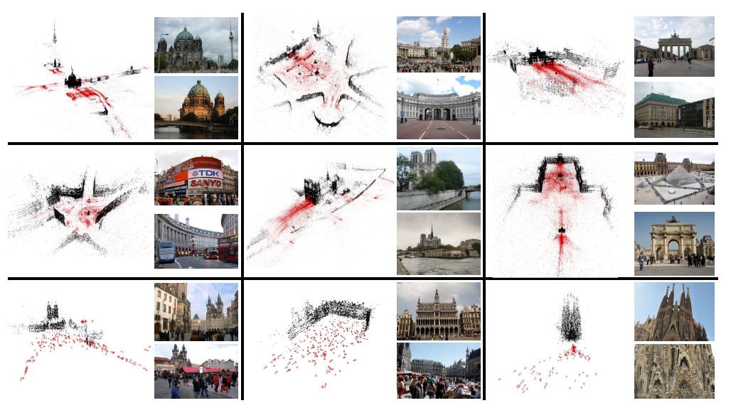
Conclusion
Achievements:
Same model-completeness
First to handling unordered world-scale datasets
~100 Mio images processed to 3D models within 6 days
While at the same time being
Adaptive
Online (streaming, on the fly)
Scalable (linear processing time)
Future research:
Streaming
Associating data (on the fly) is more difficult
Higher model completeness
New data association concepts

Slide 6


Slide 7
Open Questions
In the presentation, you are also expected to talk about the previous work and highlight the novelties proposed in the paper explicitly.
Structure from motion (SfM) is a photogrammetric range imaging technique for estimating three-dimensional structures from two-dimensional image sequences
Humans perceive a lot of information about the three-dimensional structure in their environment by moving through it. When the observer moves and the objects around the observer move, information is obtained from images sensed over time.^{[1]}
Finding structure from motion presents a similar problem to finding structure from stereo vision. In both instances, the correspondence between images and the reconstruction of 3D object needs to be found.
Visual Words: Bag of Words in Visual Computing
feature detection, feature description, and codebook generation.^{[1]} A definition of the BoW model can be the "histogram representation based on independent features".^{[2]}

Slide 8
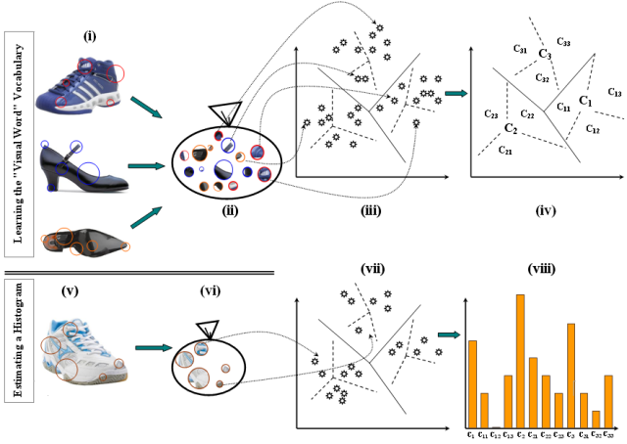
Open Questions
Vocabulary tree is a compact way to do image retrieval. Vocabulary tree is something which is made by clustering visual words into clusters.

Slide 9
Evaluation – Setup
Different datasets:
Roman Forum ~ O(10⁵)
Berlin ~ O(10⁶)
Paris ~ O(10⁶)
London ~ O(10⁶)
World by Yahoo ~ O(10⁸)
Two testing setups:
Same PC as Frahm et al. [9] to check performance with the same small-scale datasets
Better PC for ‘World by Yahoo’ dataset

Slide 10
Outlook
Future research:
Streaming
Associating data (on the fly) is more difficult
Higher model completeness
New data association concepts

Slide 11
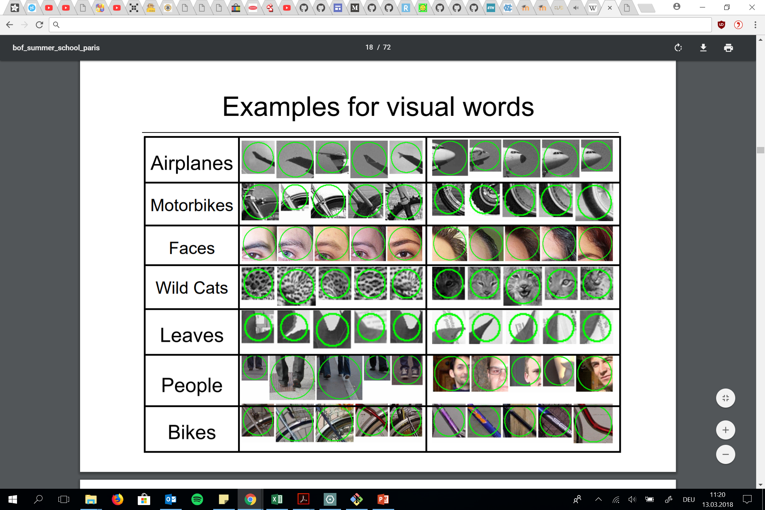
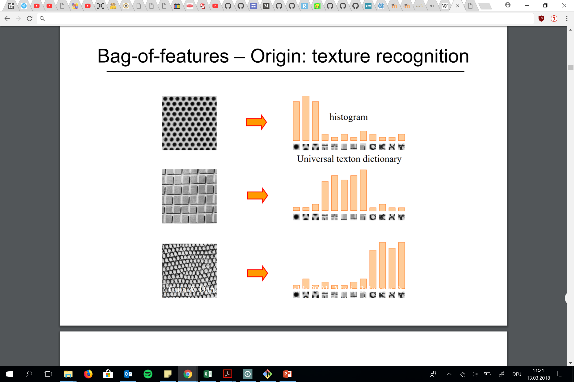
Problems
Texture is characterized by the repetition of basic elements or textons
http://www.di.ens.fr/willow/events/cvml2011/materials/CVML2011_Cordelia_bof.pdf

Slide 12
Evaluation
For a match:
>= 30 inliner matches
Ignore images if > 70% of inliners are along the outer boarder (watermarks)
Positioning camera in existing 3D model -> >= 50 P3P (BILD dazu)
Different datasets:
Roman Forum
Berlin
Paris
London
World by Yahoo

Slide 13
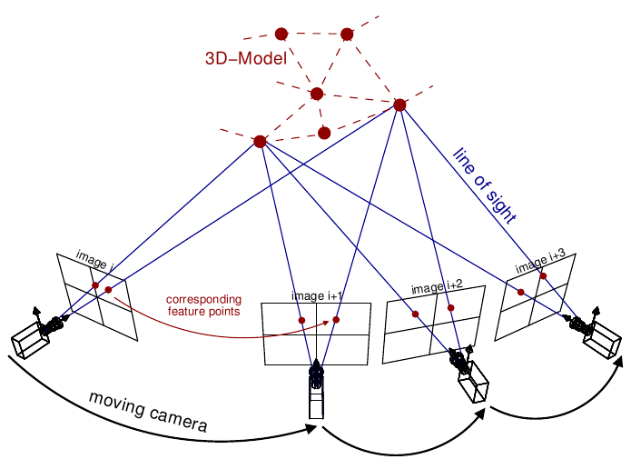
Evaluation
Split into 2 sections:
First one: Same PC as Frahm et al. [9] to check performance with the same small scale datasets
Second: Better PC: World
Different datasets:
Roman Forum
Berlin
Paris
London
World by Yahoo
Training Workflow and Diagramm of A3C high-level achitecture → Asynchronous Advantage Actor-Critic

Slide 14
New
Adaptive
Streaming
Scalable -> processing time linear (6% variance)

